Slide 1
Knowledge Graph of SOSE Research Community
Instructor - Jia Zhang Team - 5 (Sheersha, Shreyansi, Siva, Imre)
Data Intensive Workflow Development for Software Engineers (18-656) Fall 2017

Slide 2
Roadmap
Introduction
Motivation
Related work
System design
System implementation
Demo
Experiments/analysis
Conclusions and future work

Slide 3
Introduction
In this project, we aim to design and develop a software system focusing on collecting, aggregating, classifying, analyzing, reporting, and visualizing data related to Service Oriented Software Engineering (SOSE) research community.
Technologies used: Angular JS, Java Play, Neo4j and Vistrails.
Refactoring with a simple implementation with Domain Driven Design.
Datasource: DBLP datasets & Google Scholar
Notes:
2016 SOC Project
Improved Macro Architecture design
SOA-fication
Refactoring with design patterns

Slide 4
Motivation
Dblp provides information on major computer science journals and proceedings, but the information is scattered and has ambiguous relationships.
Create One stop source for information about authors and their work.
Connect Subject Experts to fellow Authors.
Stay updated about papers published by researchers.
Increase collaborative research amongst Authors.
Notes:
Predicted growth in Humans as a Service or Crowdwork
Platform to increase collaborative research
Connect experts to interested users

Slide 5


Related Work
Existing Knowledge Graph Tech in Research Community:
Google Scholars
Research Gate
However, these sites do not have any features to show the graph network of paper/authors collaborations

Slide 6
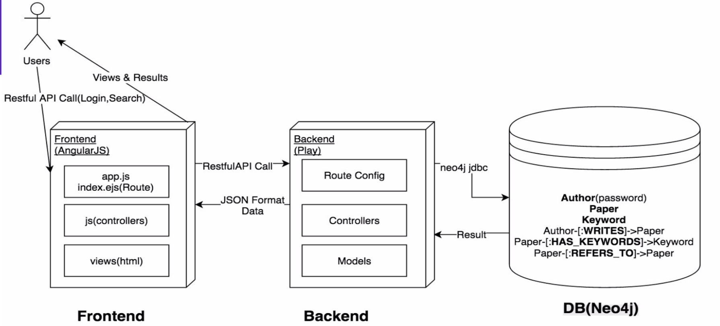
System Design

Slide 7
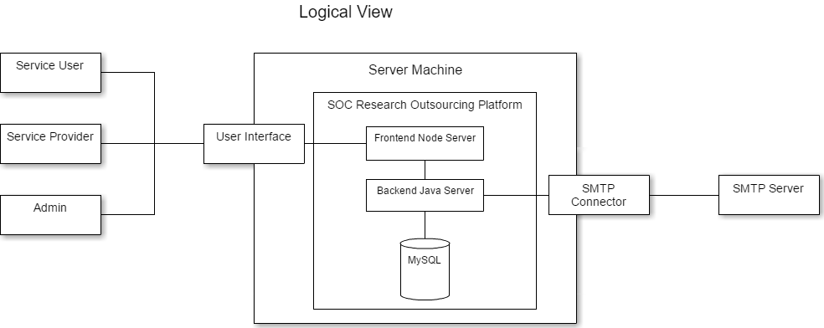
System Design - Logical View
Neo4j
Notes:
Talk about separation of backend and frontend for system implementation

Slide 8
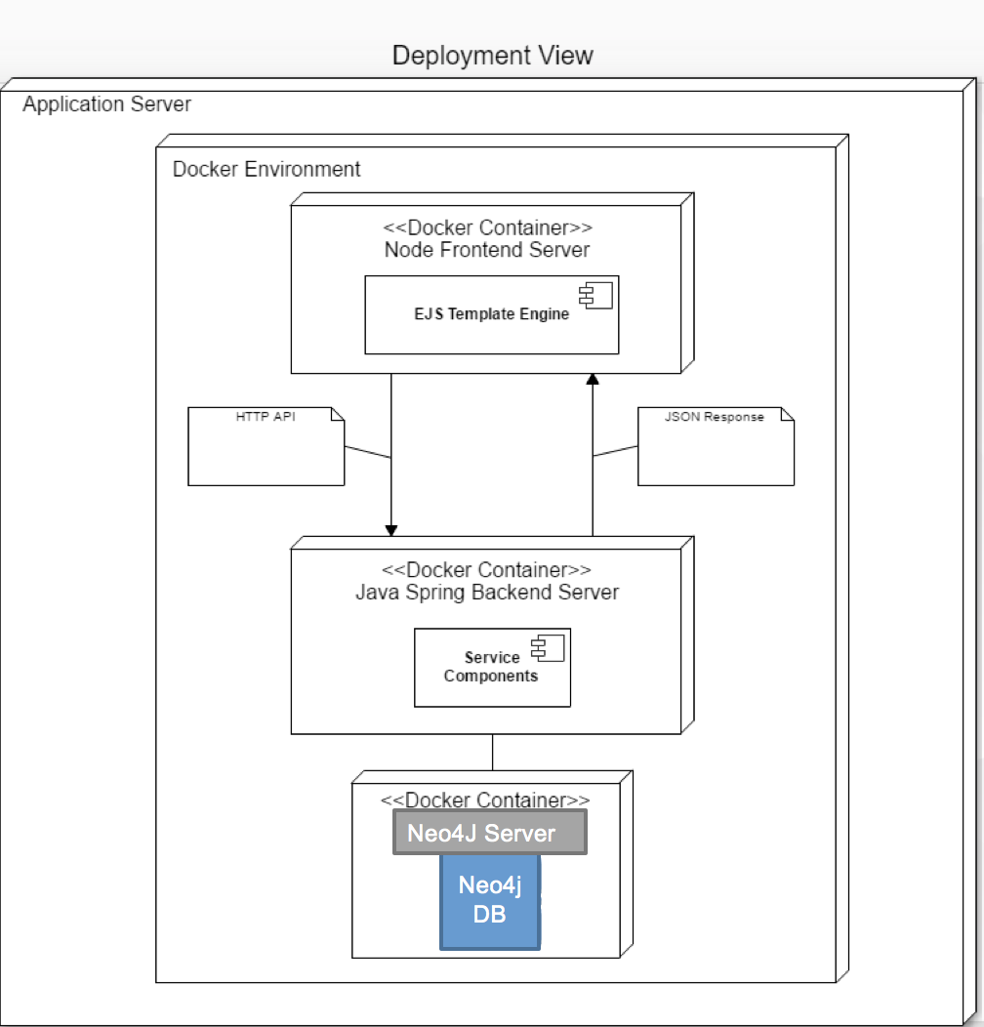
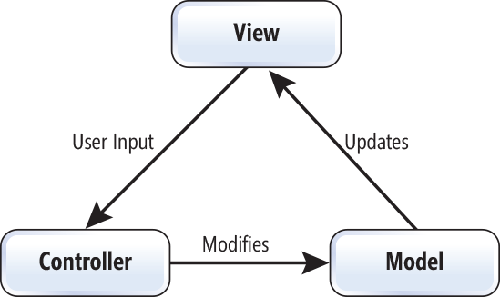
MVC & Deployment Diagram

Slide 9
System Implementation

Slide 10
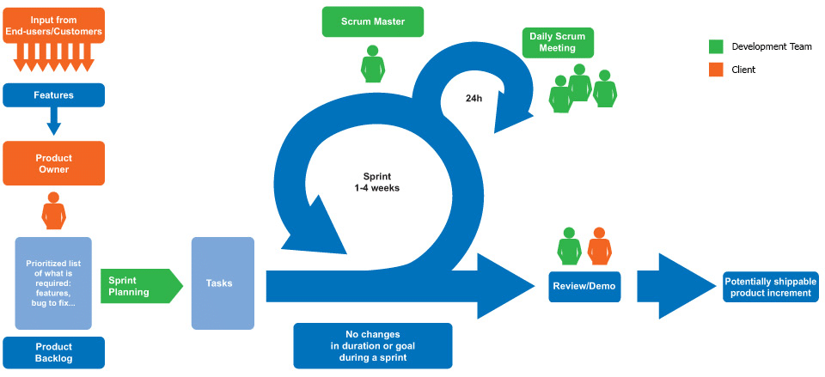
Project Development Routine
Scrum Routine:
Weekly Meeting
Frequent Discussion
Trello
Determine/Identify APIs
Divide Workload
Github
Version Control
Code Co-operation

Slide 11
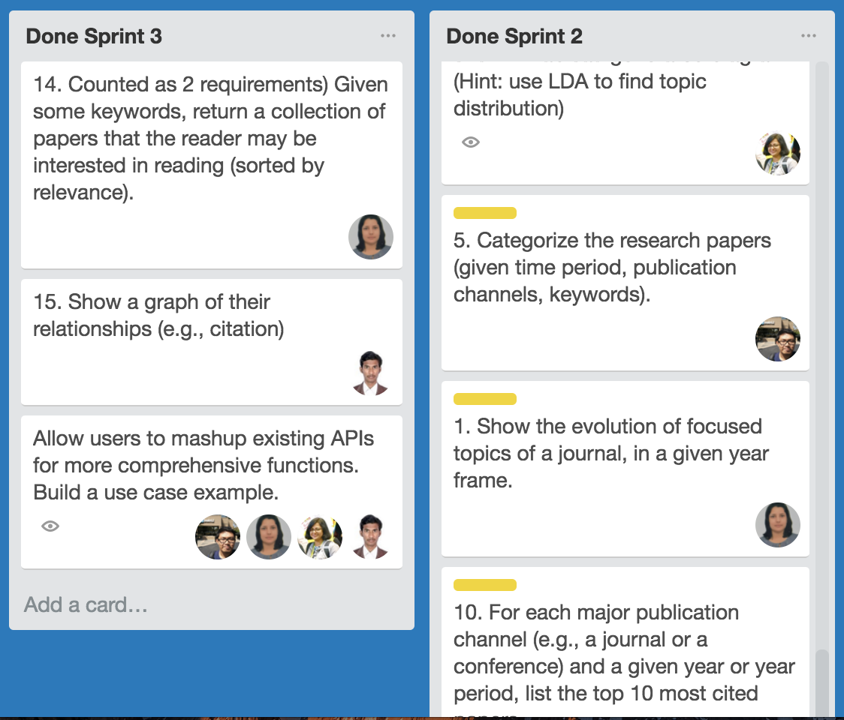
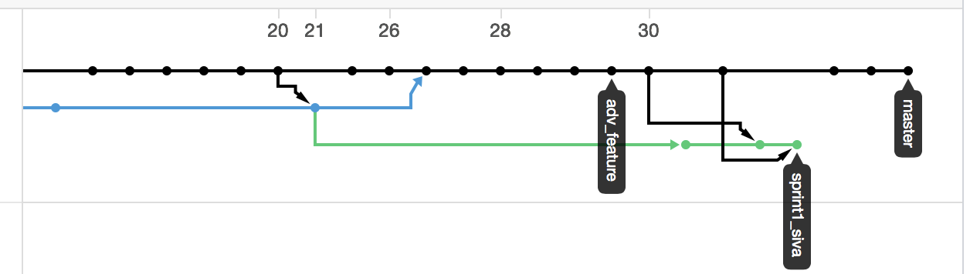
Project Development Routine
Trello Board
Github Dependency Graph

Slide 12
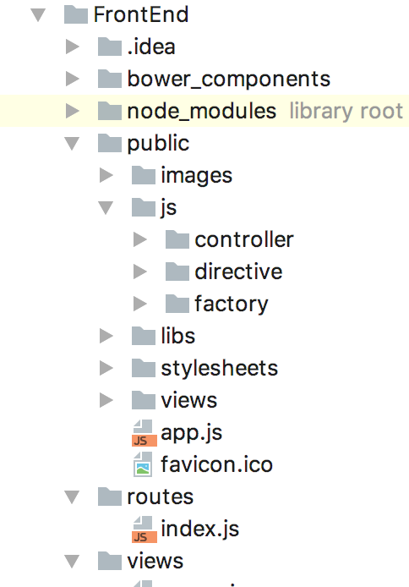
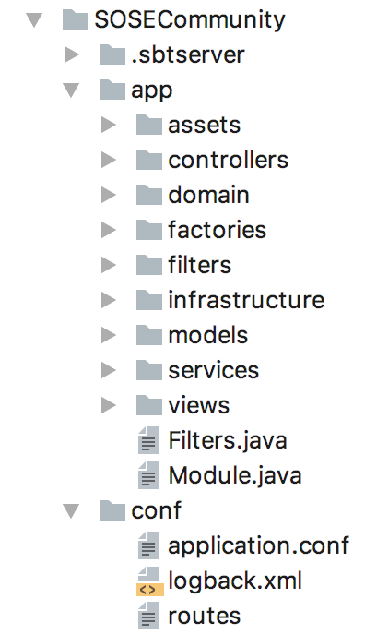
Code Structure

Slide 13
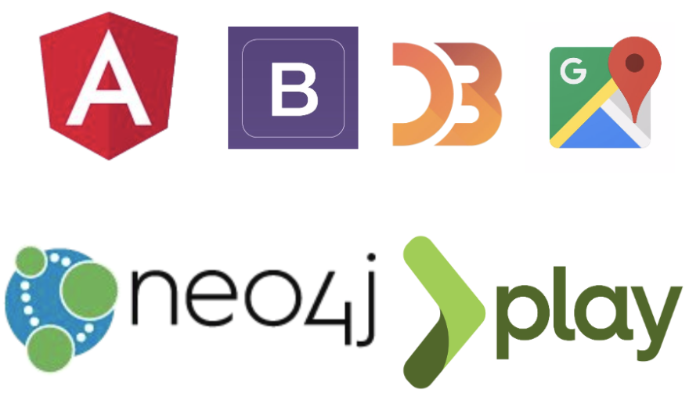



System Techniques
Frontend
Basic- AngularJS, HTML,Bootstrap
Workflow- Vistrails, Python
Visualization- Angular-nvd3, Tableau, Geochart
Backend
Play
Database
Neo4j

Slide 14
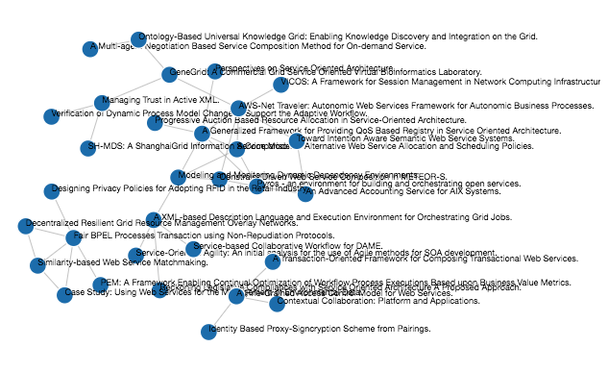
Paper-paper network
Paper relationship is captured from citation information.
Notes:
Our previous team implemented few features and fixed bugs
Loaded data from google scholar
Coming slide i am going to talk
1 paper refers other paper direct relationship, 2nd paper cites 3rd then multilevel n/w

Slide 15
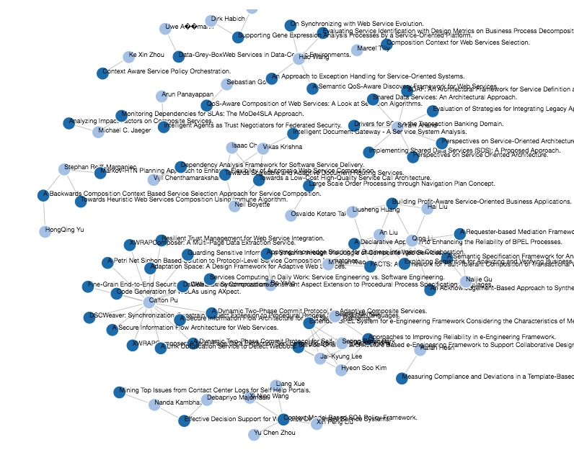
Paper-Person Network
Informations are taken from authors and the papers they've published
Notes:
Here papers by a single author

Slide 16
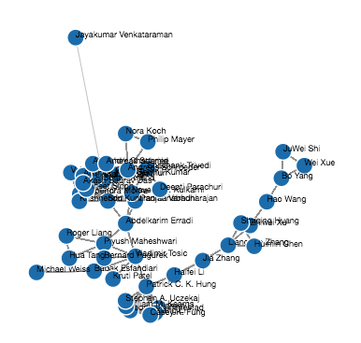
Person-Person Network
This network is constructed based on author and co-author relationships
Notes:
Multilevel couthor relationship

Slide 17
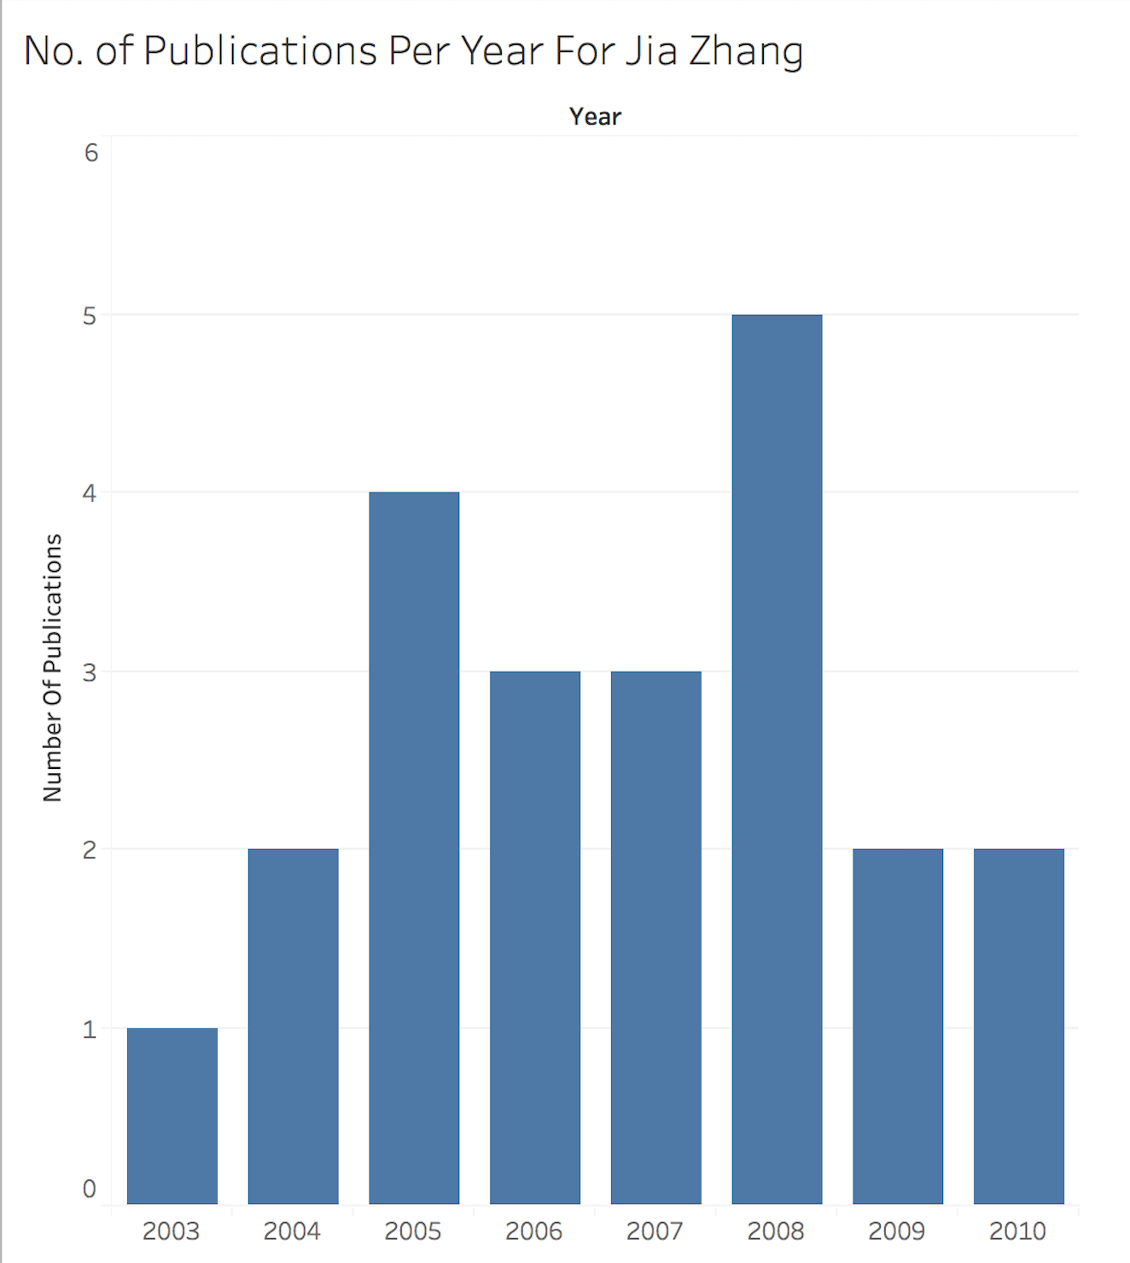
Visualization For Basic Req.
[REQ] Given a time period of years for an author, generate a histogram showing her publications per year in the field.

Slide 18
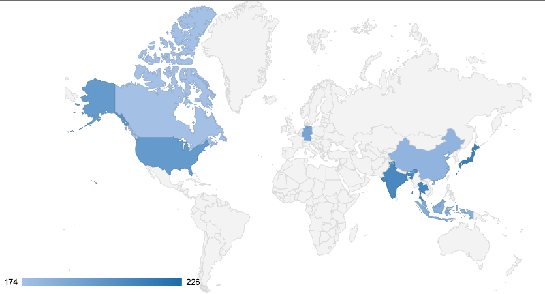
Geographical Informations
Feature to see information about the origin country of the papers
Notes:
The geographical info of Author and number whose paper published in given journal in given time frame,
we crawled to get country information for authors to get their country of origin

Slide 19
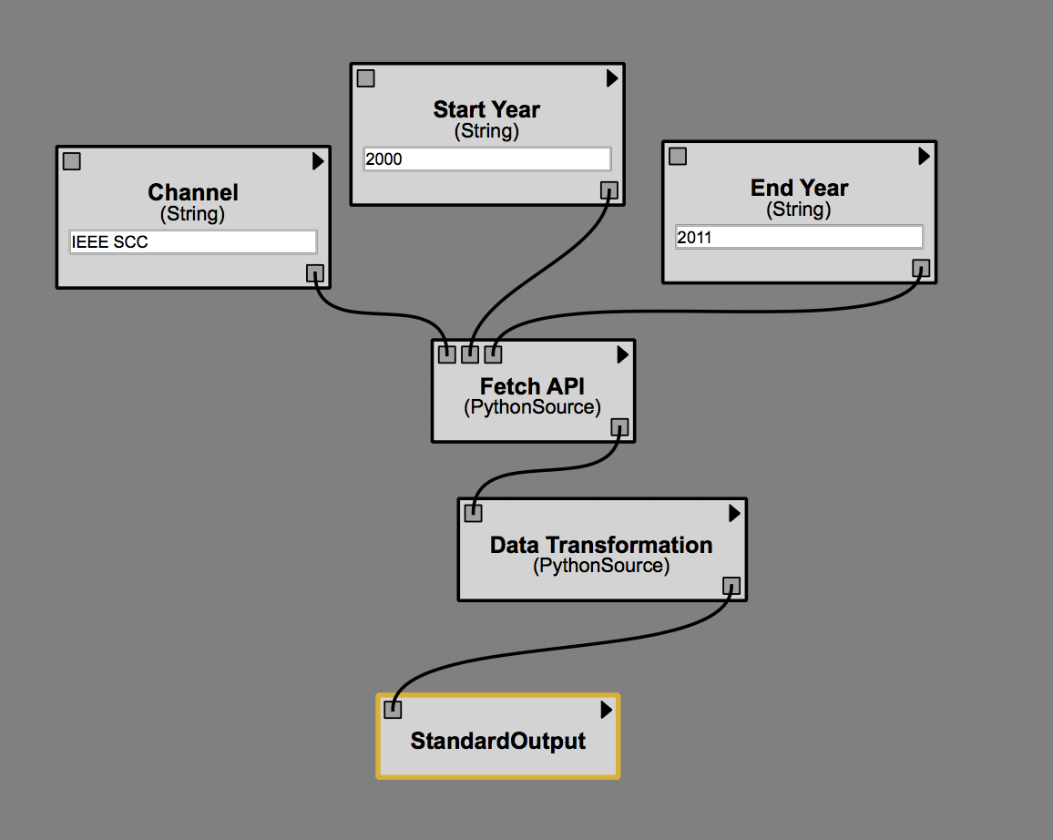
Workflow based oriented requirements
[REQ] Show the evolution of focused topics of a journal, in a given year frame.
Implementation:
Call Rest API
Transform data to Json using python
Notes:
All the papers published in the journal

Slide 20
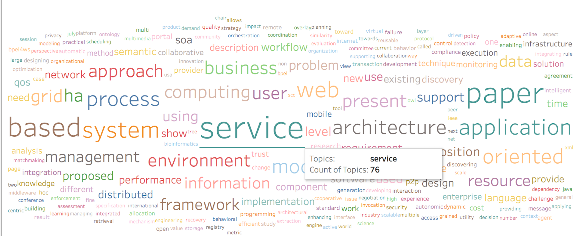
Visualization For Advanced Req.-I
[REQ] Show the evolution of focused topics of a journal, in a given year frame.

Slide 21
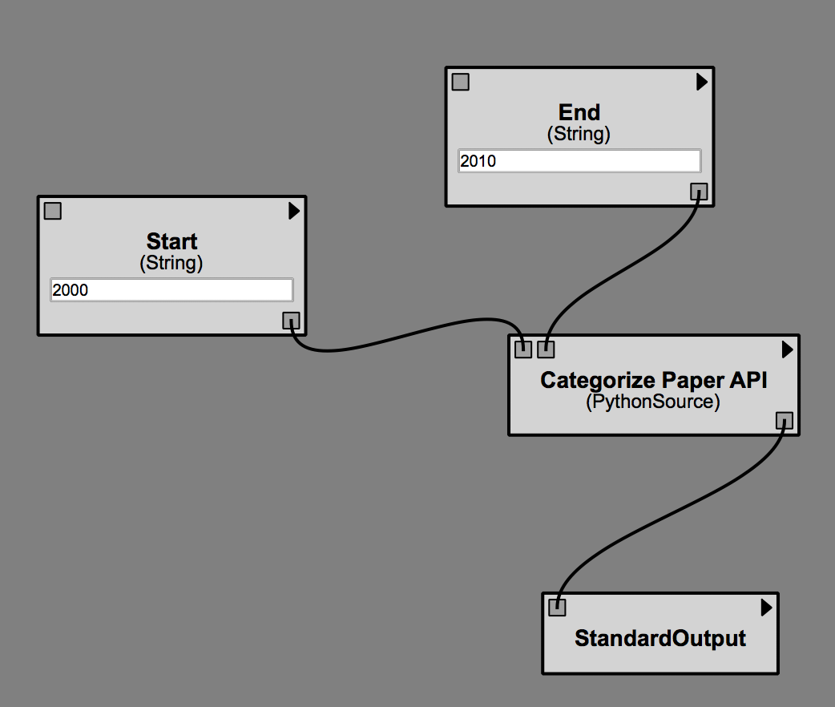
Workflow based oriented requirements
[REQ]
Categorize all research papers (given a time period)
Implementation:
Call Rest API
Transform data to Json using python

Slide 22
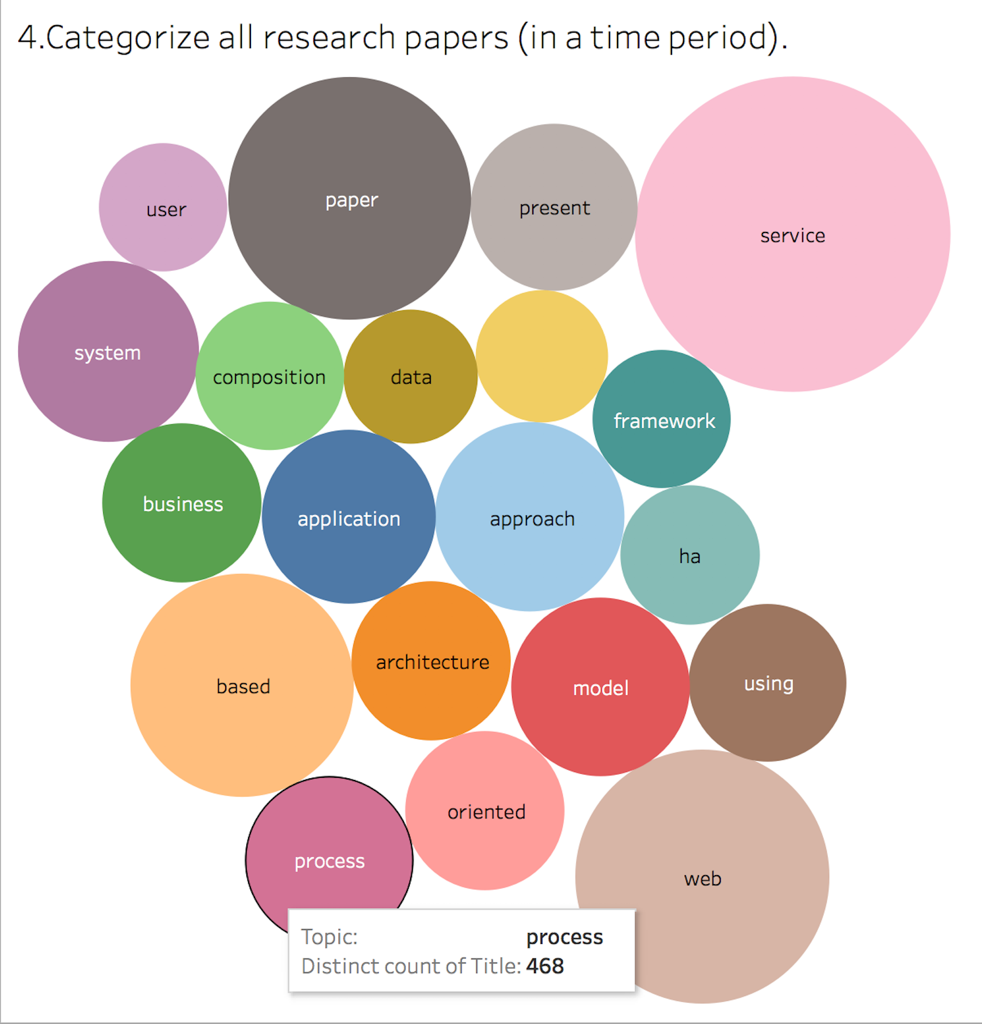
Visualization For Advanced Req.-II
[REQ] Categorize all research papers (given a time period).

Slide 23
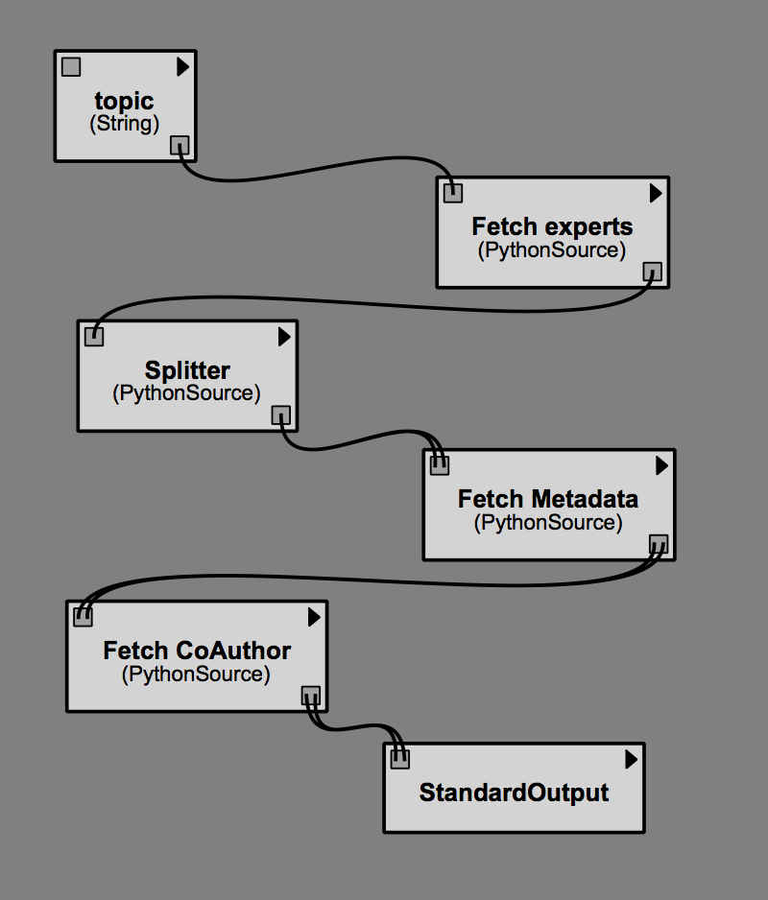
Our Mashup Service
[REQ] Given a topic keywords, retrieve all informations about the experts of that topics and their co-authors.
APIs used:
Given some keywords, search for researchers who are experts in the field (i.e., published significantly in the fields).
Given an author name, show a knowledge card with his/her metadata
Given the name of a researcher, generate a graph* showing the direct collaboration network of the author

Slide 24
Demo
https://youtu.be/4qwV_vF314w

Slide 25
Experiments and Analysis

Slide 26
Google Scholar Crawler
We develop a crawler application to pull authors metadata from google scholar's page to get these informations:
Author's affiliation, homepage, research interest, and image url
However, our crawler was detected by google as the robot and it ended up by being redirected to google robot's verification part.
Result: We were able to pull 130 author's metadata from google scholars.

Slide 27
Known Issues of Previous Project
The API responses are not consistent. Sometimes it uses JSON, and sometimes it uses text.
There is no standard in how to return graph data in JSON.
Hard to maintained because there is no chosen codestyle and understanding of the overall projects.
Bug in refreshing the page after user login.

Slide 28
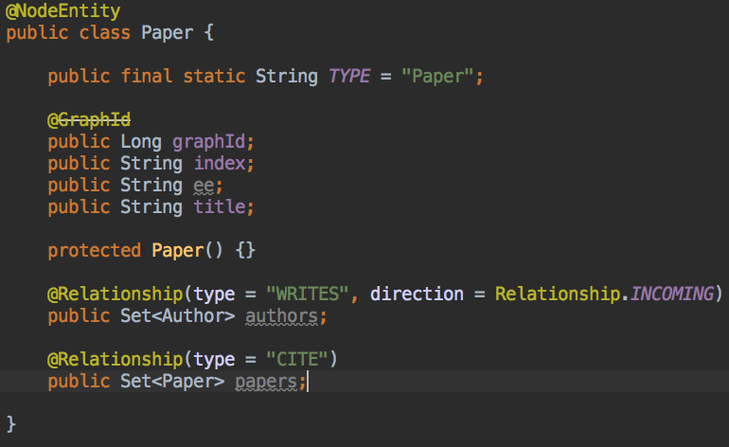
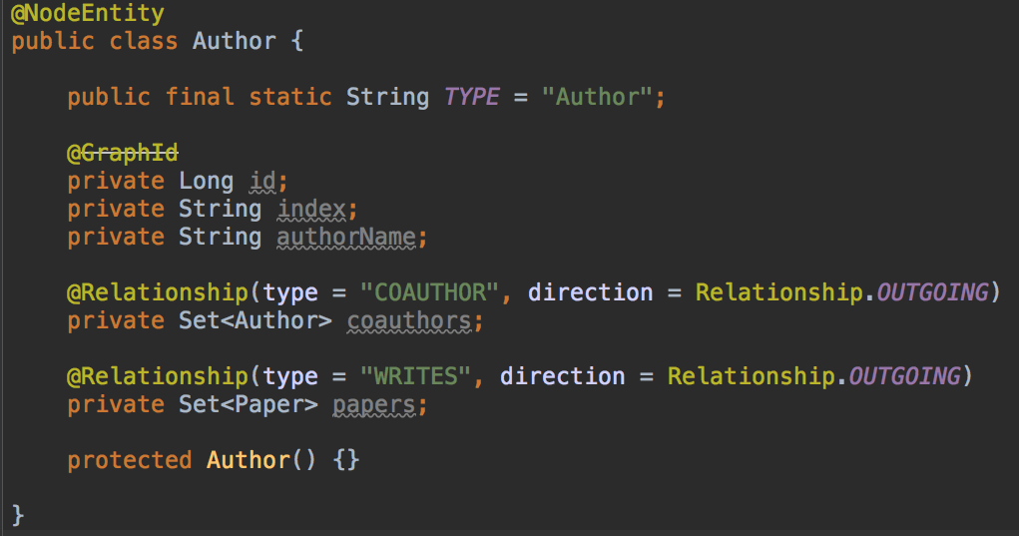
Neo4j OGM Driver
Improve code maintainability by introducing the domain concept (e.g. Author, Paper, etc) to the code.

Slide 29
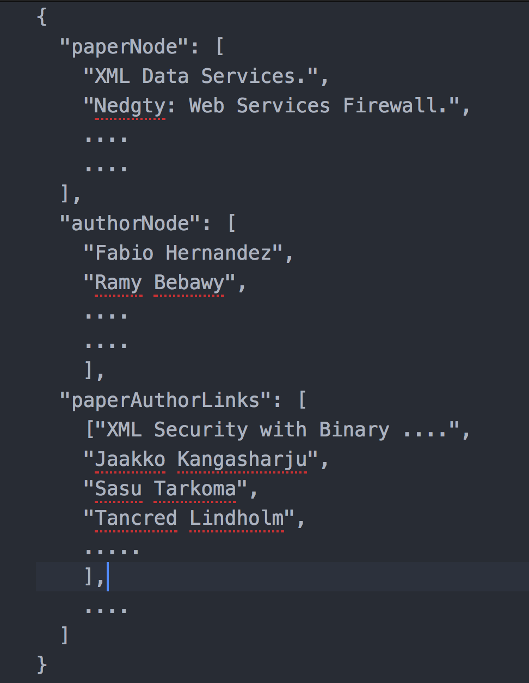
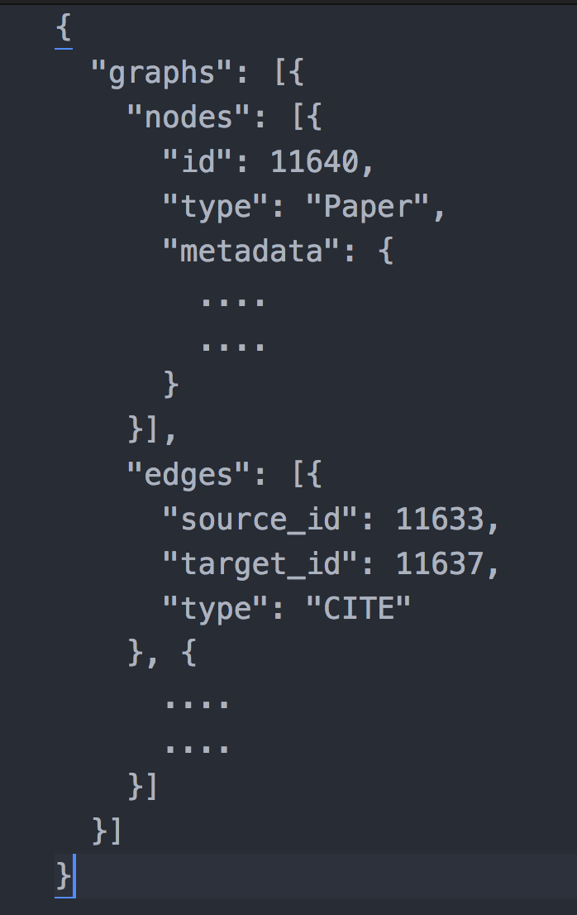
Fix the Graph data in JSON Format
1. We make the JSON more generic and reusable by removing the entity type from the JSON key name.
2. We define the relationship in better way using source and target terms.

Slide 30
Conclusion and Future Works
Application consists of a backend and frontend application, supported with Neo4J database.
All basics and advanced features have been implemented and work as expected.
Future works:
Improving the system performance by adding a cache (Redis)
Using MySQL database to store some transactional data such as login credentials etc.

Slide 31

Questions?

